Slide 2
A life of action
Notes:
School, after-school programs, sports, music lessons, dancing lessons, volunteering, tutoring, homework…
Gadgets, play stations, computers…
Constant moving from place to place, from task to task can be difficult to manage.
A life of action and constant activity need a good support system.

Slide 3
Fast-food generation
Notes:
Ideally, healthy children should receive enough nutrients from their diet. However, it is not as easy as it sounds. Sometimes children are finicky eaters and today's hectic schedules leave little time for balanced meals.
The older children get, the harder it is to manage what they eat and the vast selection of fast food joints has its undeniable influence on every kid’s diet.
A lot of fast food is high in sugar and fat, which is known to deplete energy levels and the ability to concentrate for extended periods of time. Energy and focus are especially crucial for school-aged children.
Not to mention, fast food is addictive and may lead to development of a variety of health problems.
It is often difficult to keep track of what the child eats at school or while interacting with their peers outside of home.
Given that children are reluctant to eat vegetables and fruits, they often have a shortage of many nutrients that are necessary for their development.

Slide 4
Vitamins and minerals
Notes:
Vitamins are substances that every body needs so that it can work properly.
Vitamins and minerals help to boost the immune system, support normal growth and development, and help cells and organs do their jobs. Children go through rapid periods of growth and development, which increases their need for vitamins, minerals and other nutrients.
A multivitamin designed specifically for kids' needs may help to fill any nutritional gaps in their diet, particularly the fussy ones. Many vitamins are not stored in the body, which means they need to be replaced regularly. A shortage of any one vitamin or mineral can result in poor health.
Vitamins and minerals are essential for our bodies to function and each one has a specific role to play.

Slide 5
Vitamin
Notes:
For example:
Vitamin A (as retinyl palmitate) – is a fat-soluble vitamin that acts as an antioxidant. Fat-soluble vitamins are stored in the body in organs such as the liver.
Vitamin A supports cell growth and differentiation, playing a critical role in the normal formation and maintenance of the heart, lungs, kidneys, and other organs.
Vitamin A is also critical for vision.
Night vision is extremely dependent on vitamin A. This vitamin helps to form pigments that allow our eyes to adjust to changes in light.

Slide 6
Vitamin
Notes:
Vitamin D3 (Cholecalciferol) is an essential nutrient produced in the skin.
Vitamin D is best known for its role in the development and maintenance of healthy teeth, bones and cartilage.
The primary function of vitamin D is to promote and enhance calcium and magnesium absorption, the two essential minerals necessary for strong bones. Vitamin D3 is also required for the body to be able to utilize phosphorus, and for the absorption and metabolism of vitamin A.

Slide 7
Vitamin
Notes:
Vitamin E (d-α-tocopherol) is considered a fat-soluble antioxidant that helps to maintain healthy cells and, subsequently, a healthy body.
Vitamin E is crucial for children's good health and development. It helps the body fight germs and boosts the immune system.
As an antioxidant, it helps to stabilize cell membranes and protect the tissues of the skin, eyes, and liver.
Vitamin E can be used to improve physical endurance by promoting blood circulation.

Slide 8
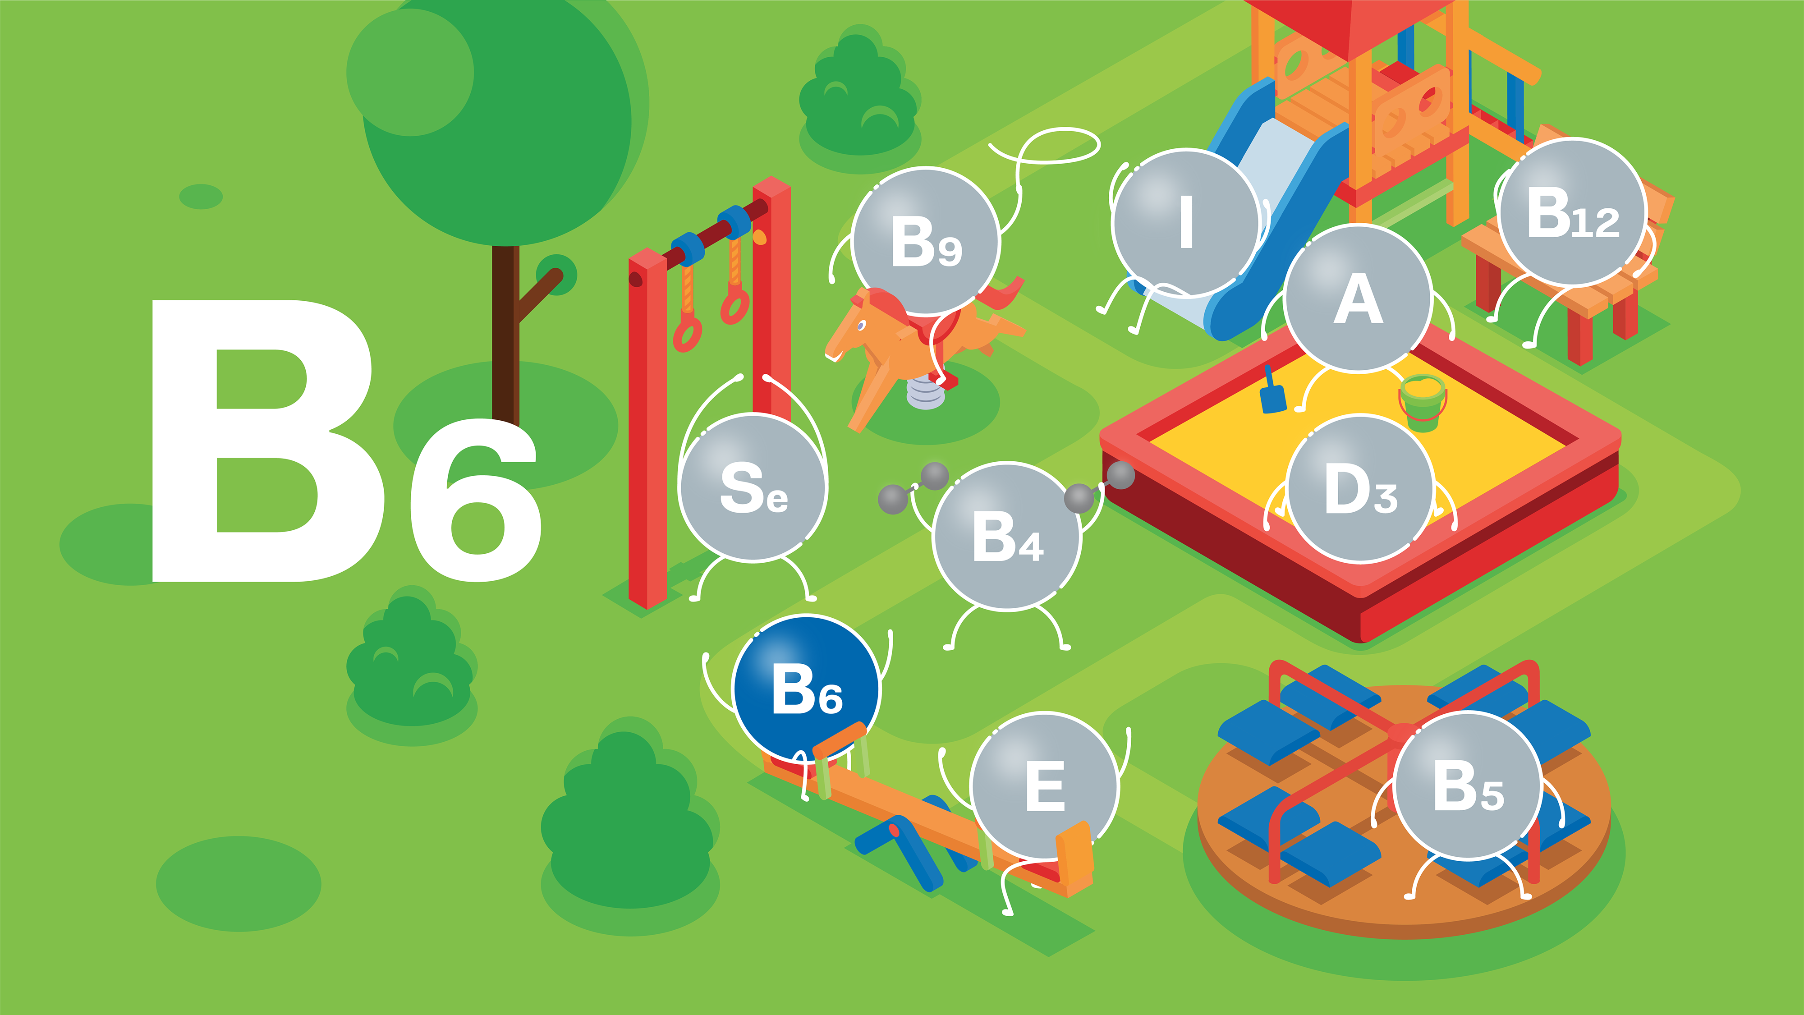
Vitamin
Notes:
Vitamin B6 (pyridoxine hydrochloride) is one of eight B vitamins.
It helps the body convert food into energy, metabolize fats and proteins, maintain proper functioning of nerves, and produce red blood cells.
It is important for cardiovascular, digestive, immune, muscular, and nervous system function.

Slide 9
Folic Acid
Notes:
Vitamin B9, Folic acid belongs to the family of water-soluble vitamins.
The human body is capable of preparing this essential vitamin, and it is then stored in the liver.
Vitamin B9 is a treasure trove of benefits for the human body and is a great source of improving overall health. Folic acid is crucial for proper brain function and plays an important role in mental and emotional health.

Slide 10
Vitamin
Notes:
Vitamin B12 (cyanocobalamin) is another water-soluble vitamin that is part of the B vitamin family.
One of the most researched vitamin B12 benefits is its ability to help in healthy regulation of the nervous system.
Vitamin B12 is needed for concentration and cognitive processes, such as learning, so a vitamin B12 deficiency can result in difficulty focusing and an increased risk for various mood and attention disorders.

Slide 11
Pantothenic acid
Notes:
Pantothenic acid (d-calcium pantothenate) - provides a multitude of benefits to the human body.
Specifically, it is critical to the manufacture of red blood cells and synthesis of cholesterol.
Vitamin B5 is also important in maintaining a healthy digestive tract.

Slide 12
Iodine
Notes:
Iodine (as potassium iodide) is an important trace mineral that is needed for normal thyroid function, and for the production of thyroid hormones.
It also helps to support normal brain function and learning ability in kids.

Slide 13
Selenium
Notes:
Selenium (as sodium selenite) is an essential trace mineral found in small amounts in the body.
It is also known as one of the most effective antioxidants that play a role in preventing cell damage.
Selenium is involved in maintaining normal liver function, protein synthesis and helps to protect the body from toxic minerals.

Slide 14
Choline
Notes:
Choline (as choline bitartrate) – is a water soluble nutrient that has a number of important responsibilities in both the brain and body and is integral for overall health.
It’s important to avoid a choline deficiency to help support various systems throughout the body, including the nervous, endocrine, and digestive systems.

Slide 15
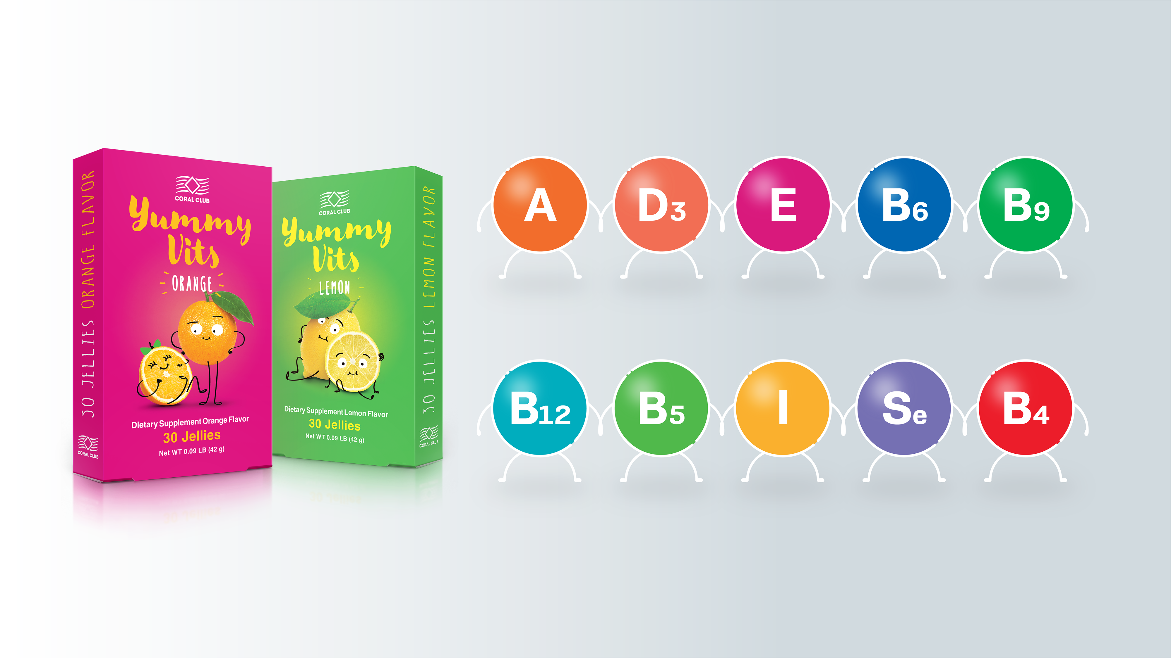
Notes:
Yummy Vits is a vitamin and mineral complex that was created for the healthy growth and development of children. Yummy vits comes in the format of chewable jellies with orange or lemon flavor that kids love.
Yummy vits do not contain sugar. Sorbitol and xylitol are the elements responsible for sweetness of the product, they help to prevent tooth decay and cavities.
This vitamin complex can help:
to overcome the period of active growth, contributing to the proper development of the musculoskeletal system*
to support the immune system and quickly recover the energy after illnesses*
to get through emotional stress*
to compensate for the deficiency of vitamins and minerals*
*These statements have not been evaluated by the Food and Drug Administration. This product is not intended to diagnose, treat, cure, or prevent any disease.

Slide 16
ConCordix®
Two-in-One
Oil-soluble
Water-soluble
Notes:
Yummy Vits were created based on high-quality ConCordix technology that allows them to combine both water soluble and oil soluble ingredients in one place. Together with natural orange and lemon flavors, the final outcome is chewable, soft fruity jellies in a blister-protected dosage form.
It was clinically proven that this form of vitamins are absorbed better compared with conventional tablets or capsules.

Slide 17
Benefits behind the ConCordix®
Bio availability
Natural flavors
State of the art production technologies
Notes:
Innovative technology behind the ConCordix®
- 44% improved bio availability* (compared to capsules, based on research published in article in Eur. J. Lipid Sci Technology 2011)
Great taste with natural flavors – sugar free
Highest standards in the production facilities
State of the art production technologies

Slide 18
All in one
Notes:
All the benefits in one place:
Chewable jellies with fruity flavor
No water needed
Gluten free
Sugar free
Great taste with natural flavors
Provides the body with essential vitamins in bioavailable form
Convenient packaging is always with you
Easy to carry, easy to take

Slide 19
Yummy Vits by Coral Club
(30 jellies)
Retail price $15.00
Club Member Price $12.00
VP 8

Slide 20
Yummy Vits — for an active lifestyle!

